Slide 1


PREDICTING WINE QUALITY
POURING INSIGHTS:
TEAM 4

Slide 2


FACTS ABOUT
WINE
Imagine a time long ago when the word “wine” was first uttered by our ancestors. Derived from the Proto-Indo-European word “win-o,” which means “friend,” wine has been a cherished companion to humankind.
Does a glass a day really keep the doctor away? Although the effects of wine on the heart are still being researched, studies show that the antioxidants in wine can lower your risk of having heart diseases.
Unearthed in a Roman tomb, the world’s (known) oldest bottle of wine was excavated in 1867.
It’s just a general rule of thumb, but women typically have a better sense of smell than men, making them better tasters. Don’t shoot the messenger!

Slide 3

ABOUT THE
DATASET
Sourced from Kaggle, our data comprises of 32485 wine instances. Each instance includes information on 12 different features or ingredients that are used to predict the quality and type of the wines.
The dataset focuses on predicting one target variable: quality, based on some analysis and modeling.
Quality is categorized into seven classes (3 to 9), providing a range of possible quality levels.
Some of the columns are citric acid, residual sugar, sulfur dioxide, pH, alcohol, etc

Slide 4


EXPLORATORY DATA ANALYSIS

Slide 5
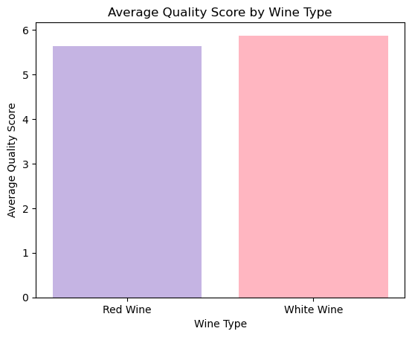
DO CERTAIN TYPES OF WINE (RED OR WHITE) TEND TO HAVE HIGHER QUALITY SCORES ON AVERAGE?
The bar chart clearly shows the average quality scores for red and white wines.
White wine has a higher average quality score compared to red wine.
The average quality score provides a general indication of the perceived quality of wines within each category.

Slide 6
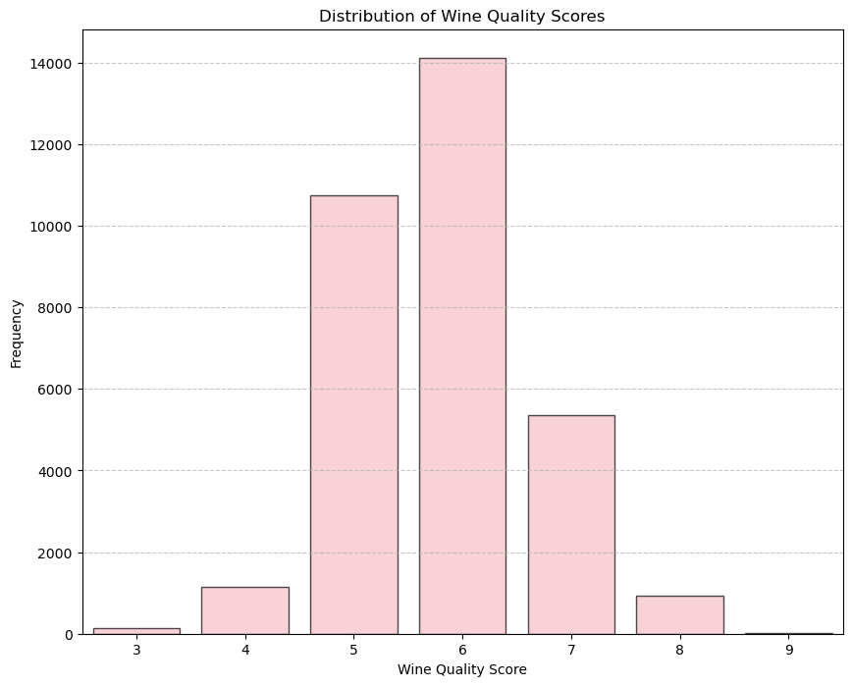
WHAT IS THE RANGE OF WINE QUALITY SCORES, AND HOW CAN WE IMPROVE THIS RANGE THROUGH ANALYSIS AND RECOMMENDATIONS?
Quality score 6 is the most common, with the highest frequency among the quality scores. This suggests that a significant portion of the wines in the dataset has been rated as '6.'
The distribution appears to be somewhat right-skewed, with a higher frequency of wines receiving quality scores in the mid-range (5 to 8).

Slide 7
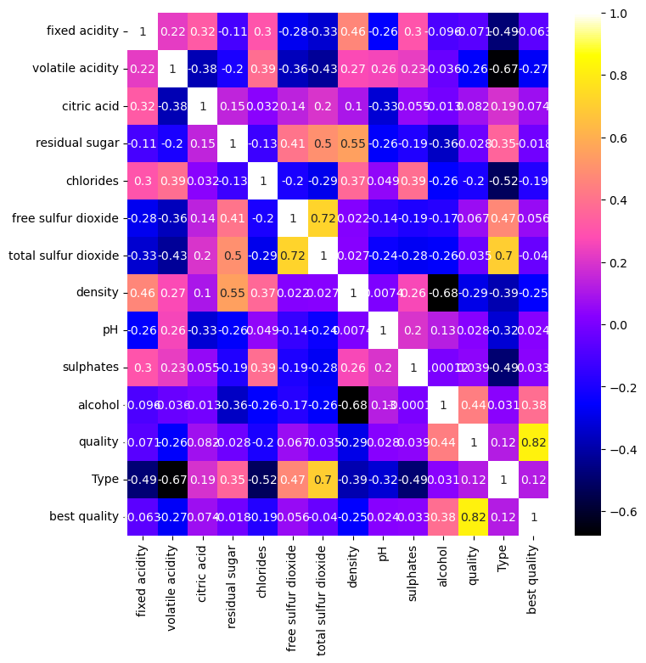
CORRELATION ANALYSIS
The variables 'total sulfur dioxide' and 'free sulfur dioxide' exhibit a strong positive correlation, suggesting a potential redundancy in the dataset.
'Alcohol' content shows a positive correlation with 'quality,' indicating that wines with higher alcohol content tend to receive higher quality ratings.
'Chloride' and 'density' exhibit negative correlations with 'quality,' suggesting that higher chloride levels and density may be associated with lower wine quality ratings.

Slide 8
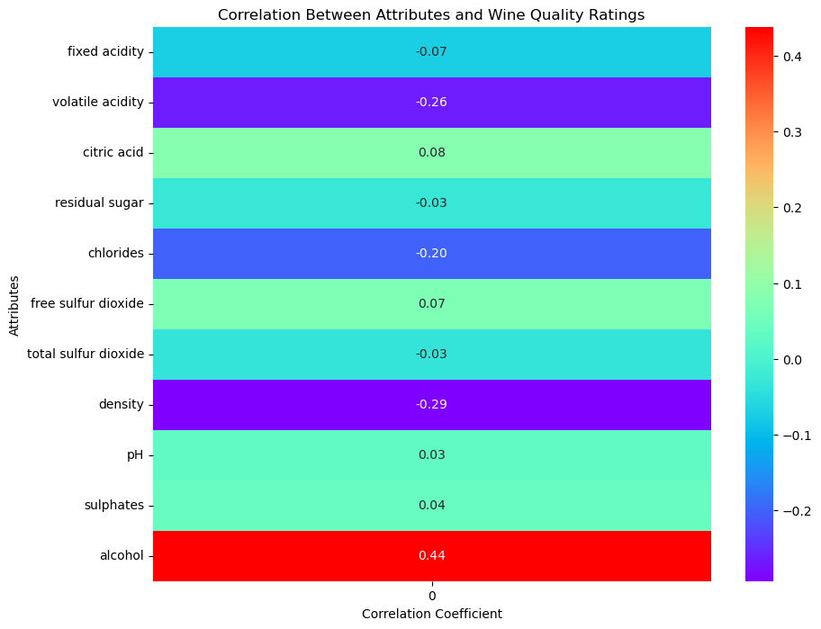
CAN WE QUANTITATIVELY MEASURE THE CORRELATIONS BETWEEN ALL ATTRIBUTES AND WINE QUALITY RATINGS?
The attribute with the highest positive correlation to wine quality is alcohol content. Higher alcohol content tends to be associated with higher quality ratings.
There are positive correlations with other attributes as well, which include fixed acidity, citric acid, sulphates, etc.
Density and volatile acidity show the least correlation with wine quality.

Slide 9
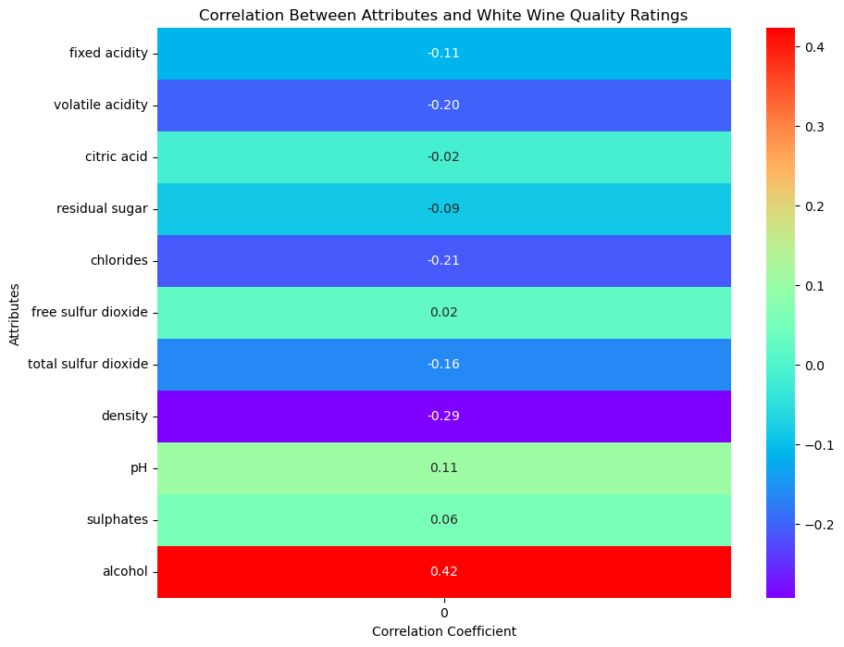
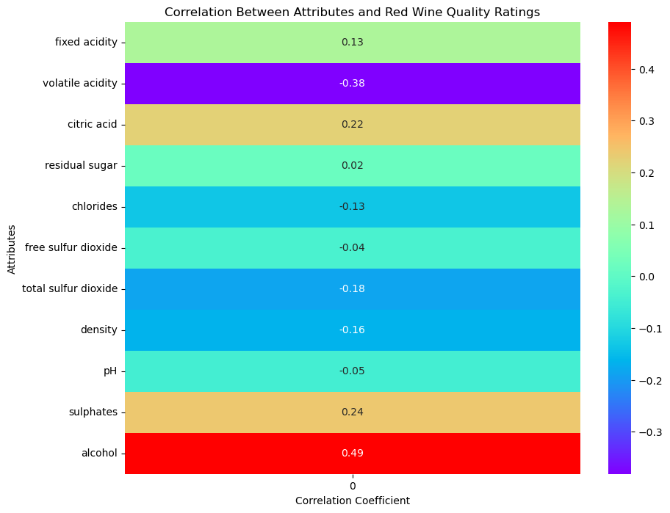
CORRELATION ANALYSIS
BETWEEN RED WINE, WHITE WINE AND ATTRIBUTES

Slide 10
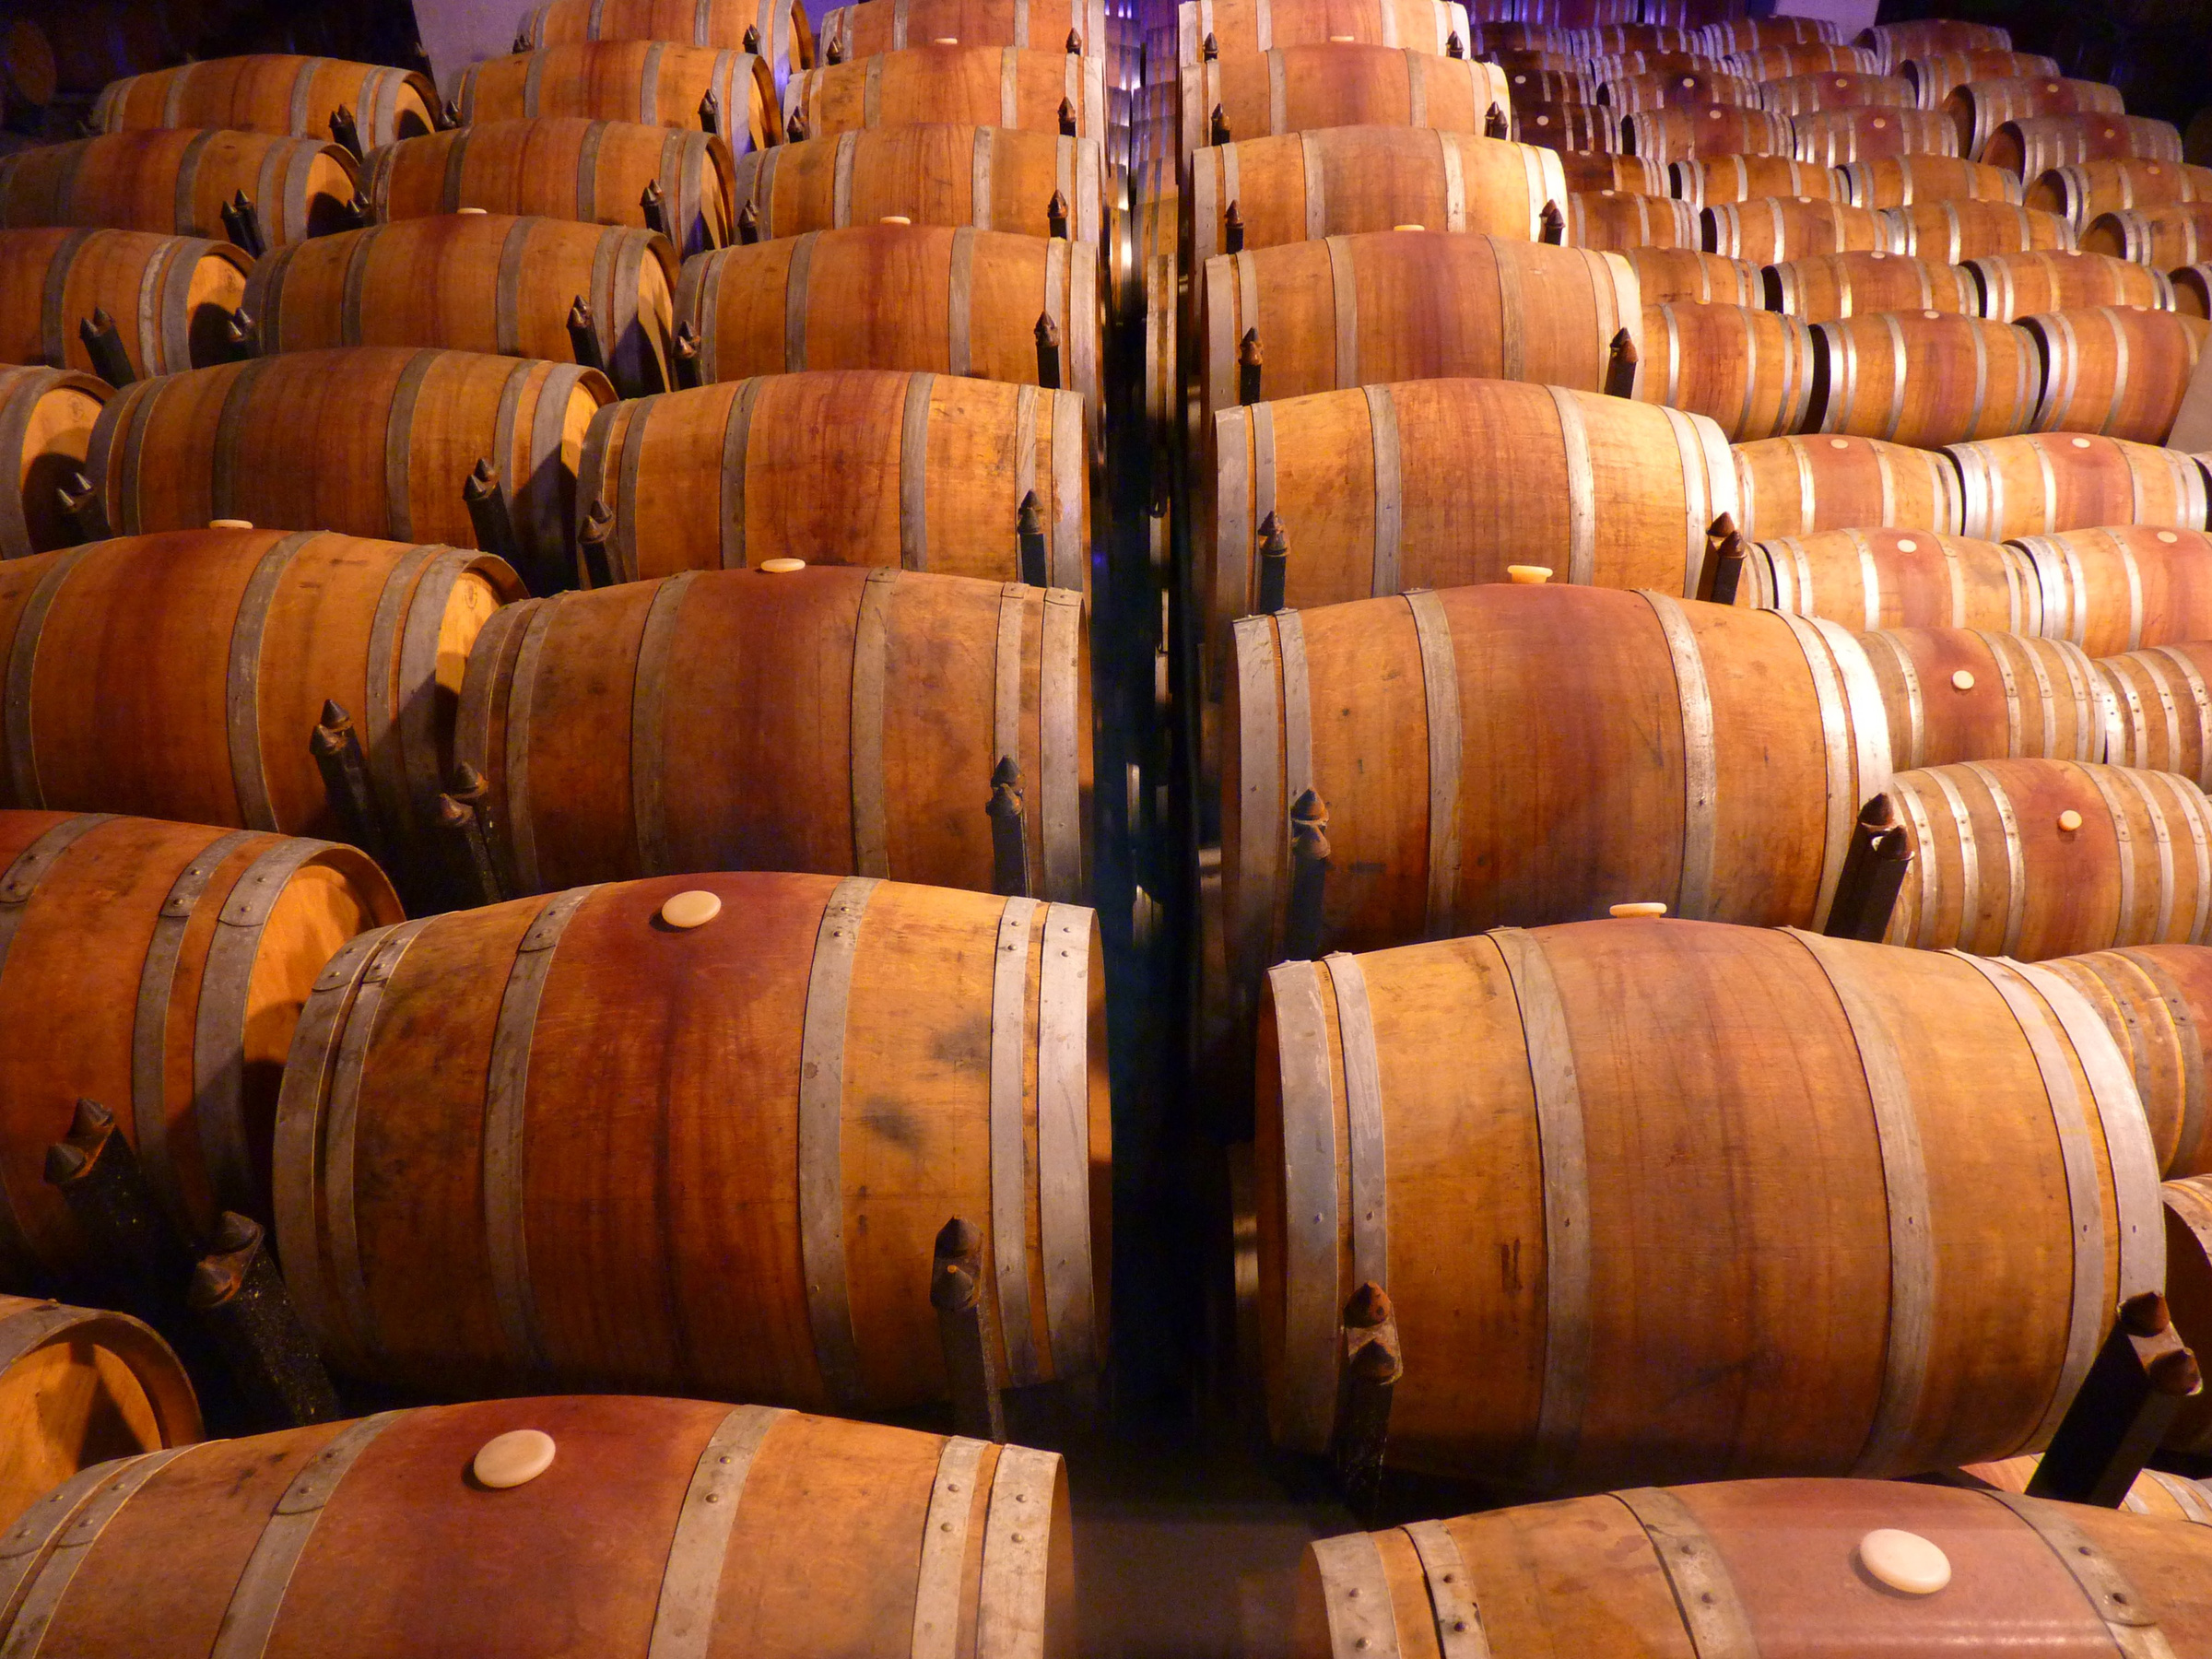
PREDICTIVE IMPACT OF TOP CORRELATED FEATURES ON WINE QUALITY
ANALYSIS OF ALCOHOL, DENSITY, VOLATILE ACIDITY ON QUALITY

Slide 11
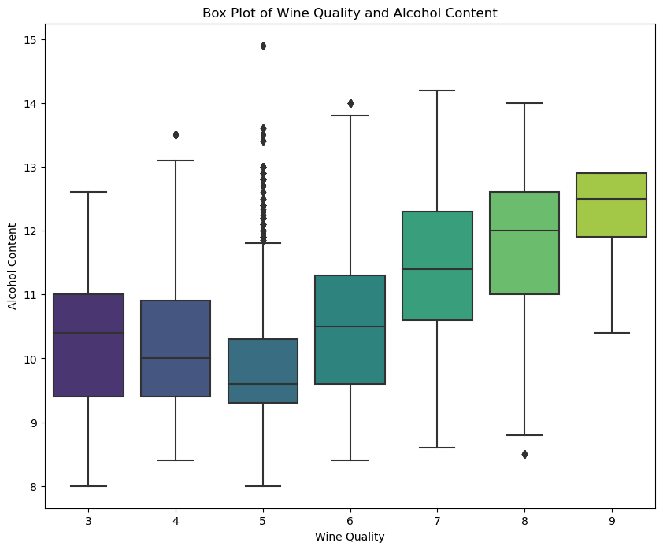
ALCOHOL VS QUALITY
There is an increasing trend of alcohol percentage with the quality rating

Slide 12
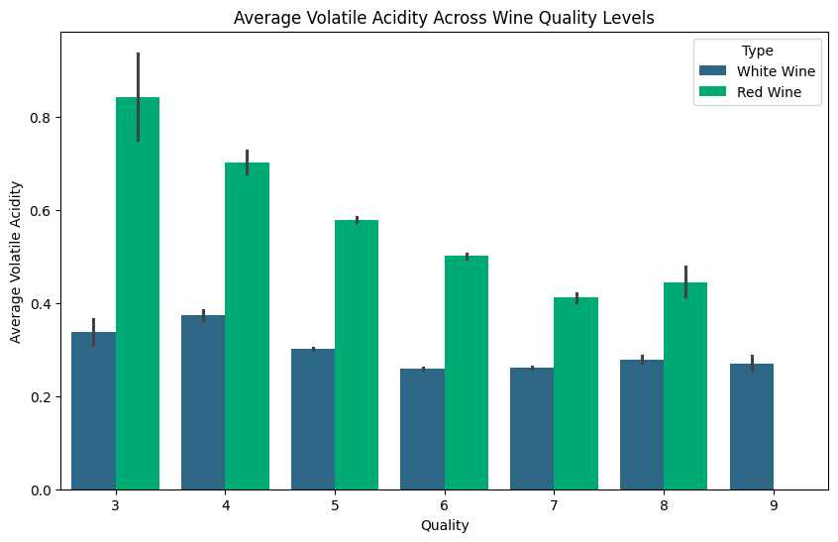
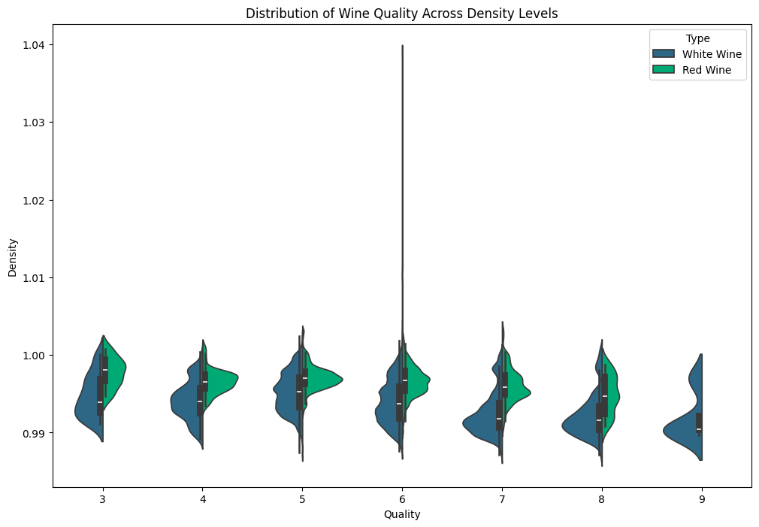
VOLATILE ACIDITY VS QUALITY
DENSITY VS QUALITY

Slide 13
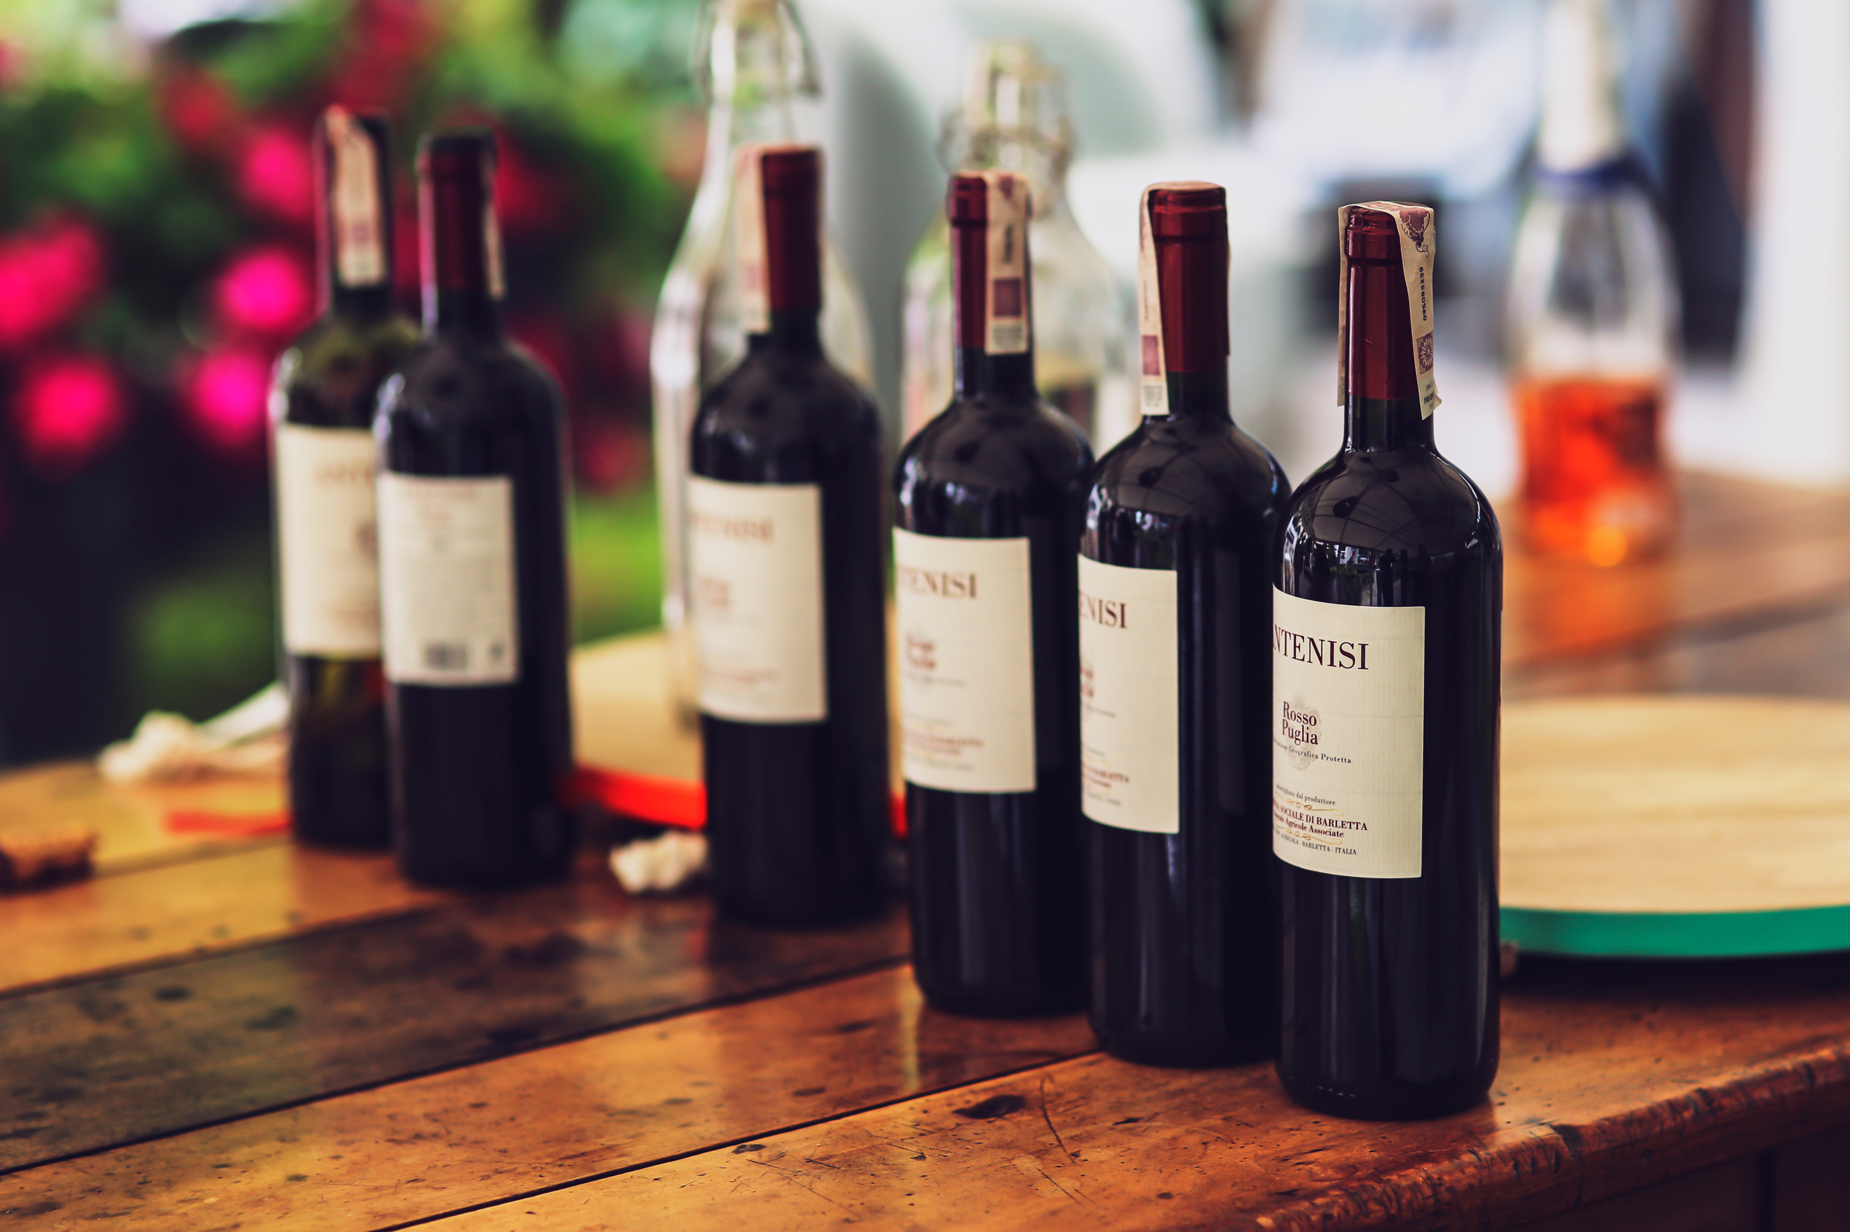

MODEL EVALUATION

Slide 14
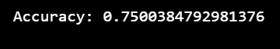
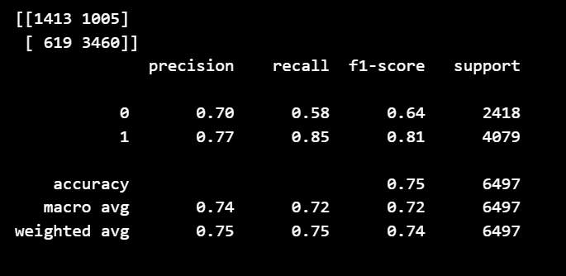
LOGISTIC REGRESSION
It indicates reasonable performance in predicting the target variable based on the features in the test data.
The model has lower precision and recall, indicating a trade-off between precision and recall.
The macro and weighted averages of precision, recall, and F1-score are also lower, reflecting the overall moderate performance of the model.

Slide 15

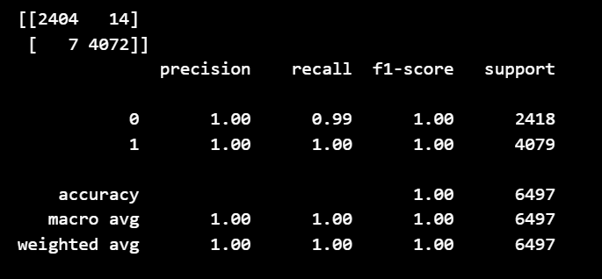
DECISION TREES
The Decision Tree Classifier demonstrates excellent performance, as reflected in high accuracy, a well-balanced confusion matrix, and strong precision, recall, and F1-score metrics for both classes.

Slide 16

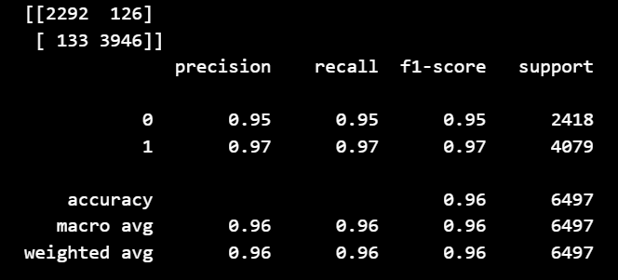
K NEAREST NEIGHBORS
The KNN Classifier demonstrates good performance with high accuracy, a well-balanced confusion matrix, and strong precision, recall, and F1-score metrics for both classes but lower than decision trees

Slide 17
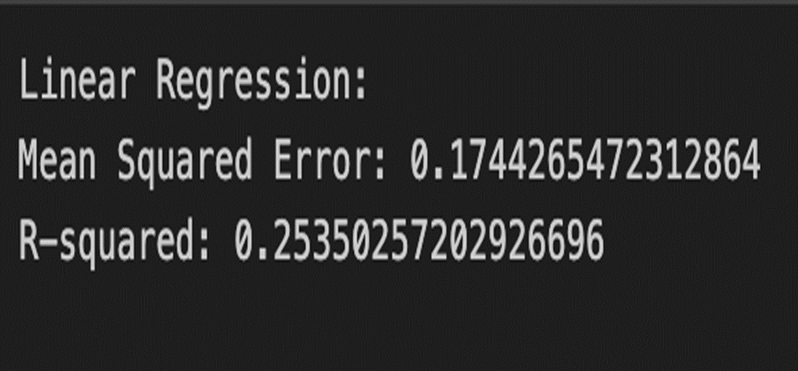
LINEAR REGRESSION
•The model's R-squared of 0.2 suggests limited explanatory power, explaining only a small portion of the variance in the data.
•Mean Squared Error of 0.17 means the average squared difference between predicted and actual values.

Slide 18
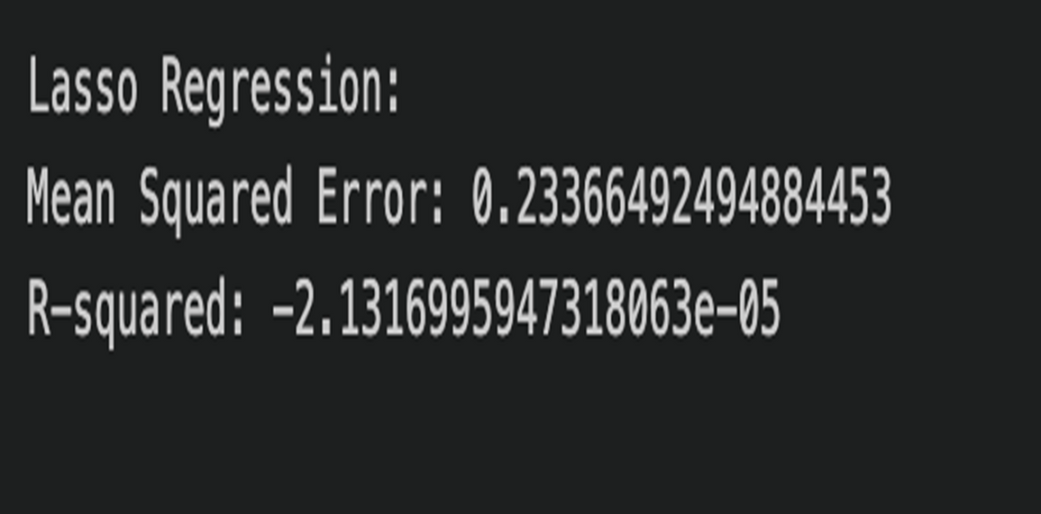
LASSO REGRESSION
The negative R-squared indicates either a poor fit of the model or possible overfitting problems, while the MSE of 0.23 indicates some degree of prediction error.
This suggests that the relationships between predictors and the target variable in the dataset are not being adequately captured by the model.

Slide 19
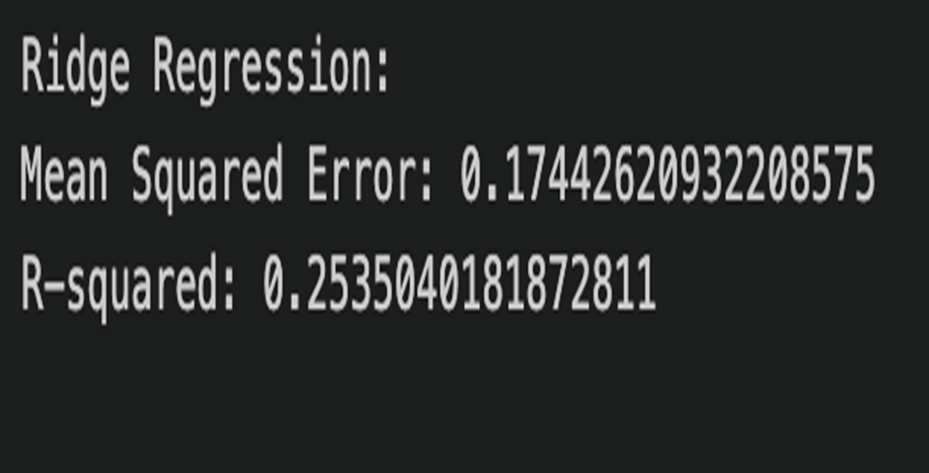
RIDGE REGRESSION
The R-squared for the Ridge Regression model was 0.25, meaning that the model explains around 25% of the variance in the target variable.
The moderate amount of prediction inaccuracy is shown by the MSE of 0.17.
The model performs better overall, exhibiting a moderate ability to capture interactions between predictors and the target variable.

Slide 20

MODELING BASED ON HIGHLY CORREALATED FEATURES
Based on the correlation matrix we find that Alcohol, density, chlorides, and volatile acidity are the attributes that are highly correlated.
So we tried building our model based on just these four features and for each model we got the same accuracy and confusion matrix table.
This tells us that working on just the highly correlated attributes we can build a model which is as accurate as working with all attributes.
This saves us a lot of time and effort when working on a large dataset.

Slide 21

CONCLUSION
The analysis highlights that white wines generally receive higher quality ratings than red wines, with alcohol content being strongly correlated with better ratings.
Attributes like fixed acidity, citric acid, and sulphates also positively influence wine quality, while density and volatile acidity show negative correlations.
Quality scores tend to center around 6, suggesting a prevalent rating trend. The dataset exhibits some redundancies between sulfur dioxide variables.
Machine learning models, particularly Decision Trees and KNN Classifiers, perform well in predicting wine quality, with Decision Trees showing slightly better overall metrics than KNN, although both demonstrate reasonable predictive capabilities.

Slide 22


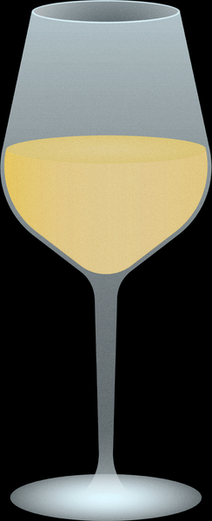

THANK YOU
TEAM 4

